Slide 1
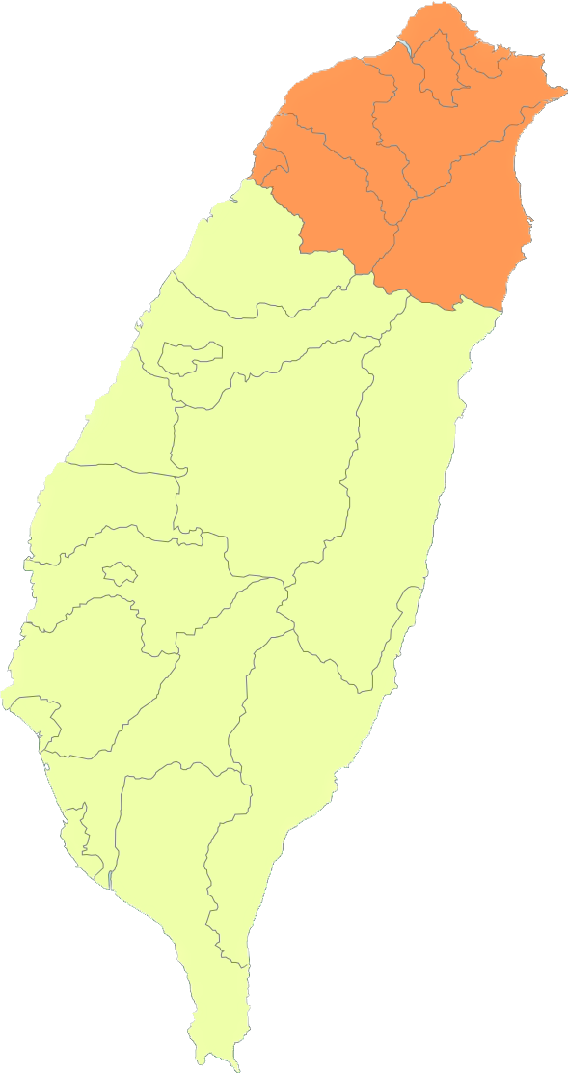

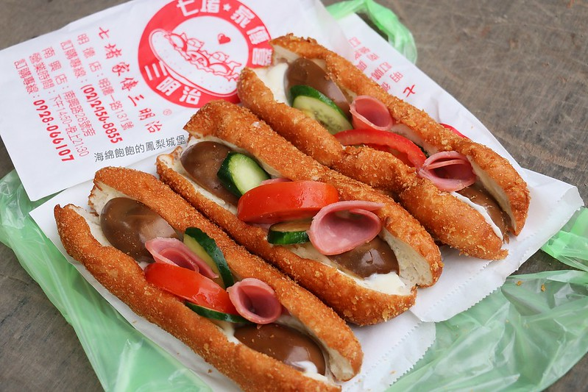
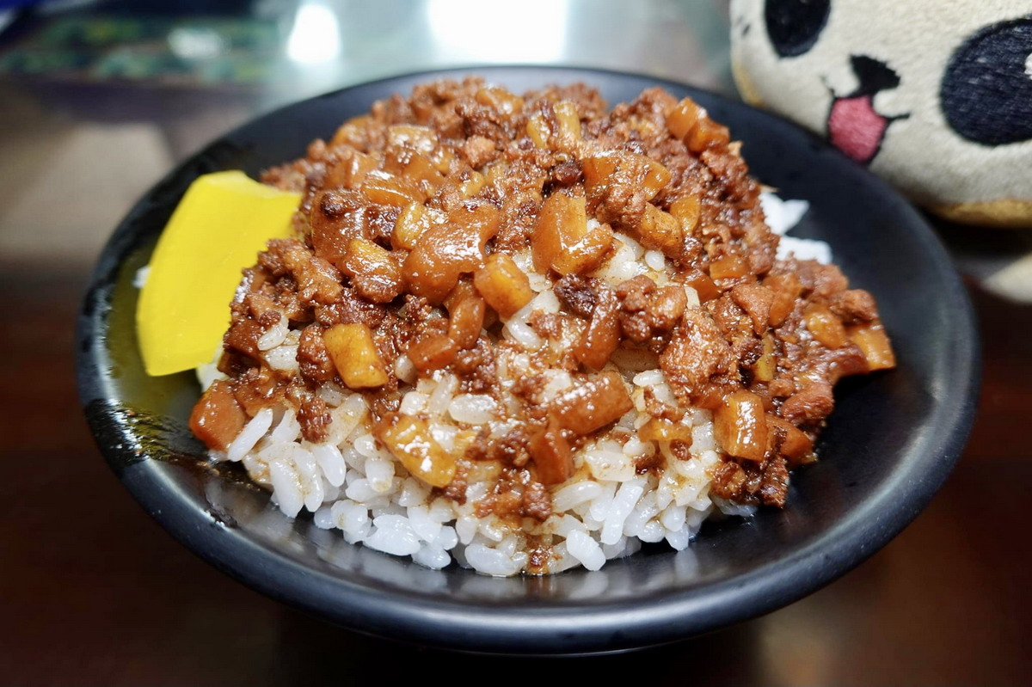
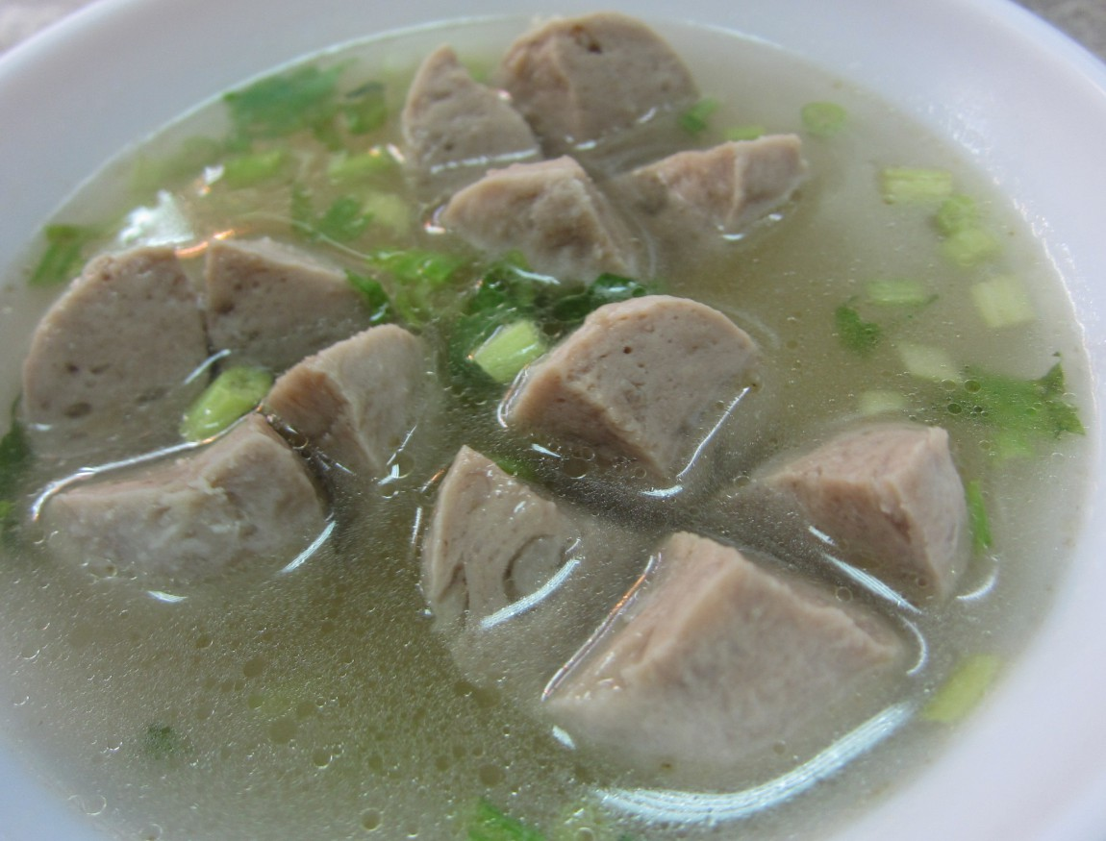





Taiwan Xiao-Chi
Differ between Northern and Southern Xiao-Chi
Northern Xiao-Chi
Southern Xiao-Chi
Shopping List
Northern Xiao-Chi
In northern of Taiwan, the proportion of population that immigrated from China after War II is greater than southern of Taiwan. As a result, it is more common to see Chinese cuisine in the northern of Taiwan, and people usually prefer salty flavor of food.
Generally, the area of northern Taiwan is showed as right side. Basically, the criteria of which county is belonged to northern or southern of Taiwan is not only by its position but by the live style of local residents .
From China
Salad Boat
Lo Bah Png
Kong Oan
Taiwan Xiao-Chi
Northern Xiao-Chi
Southern Xiao-Chi
Differ Between northern and Southern Xiao-Chi
Shopping List

